Slide 1

RISE OF PERSONAL ROBOTS IN OUR LIVES
‘The Robots Are About People’
Mayur Nilkanth Talole.
Gr no.-111227
Under guidance of
Prof. S.M.Tayde
Bansilal Ramnath Agarwal Charitable Trust’s
Vishwakarma Institute of Technology
Department of Electronics Engineering
Academic year 2013-14

Slide 2
Agenda
Personal robotics
Robots in communication
Robots in health
Robots in media
To build one
Conclusion

Slide 3
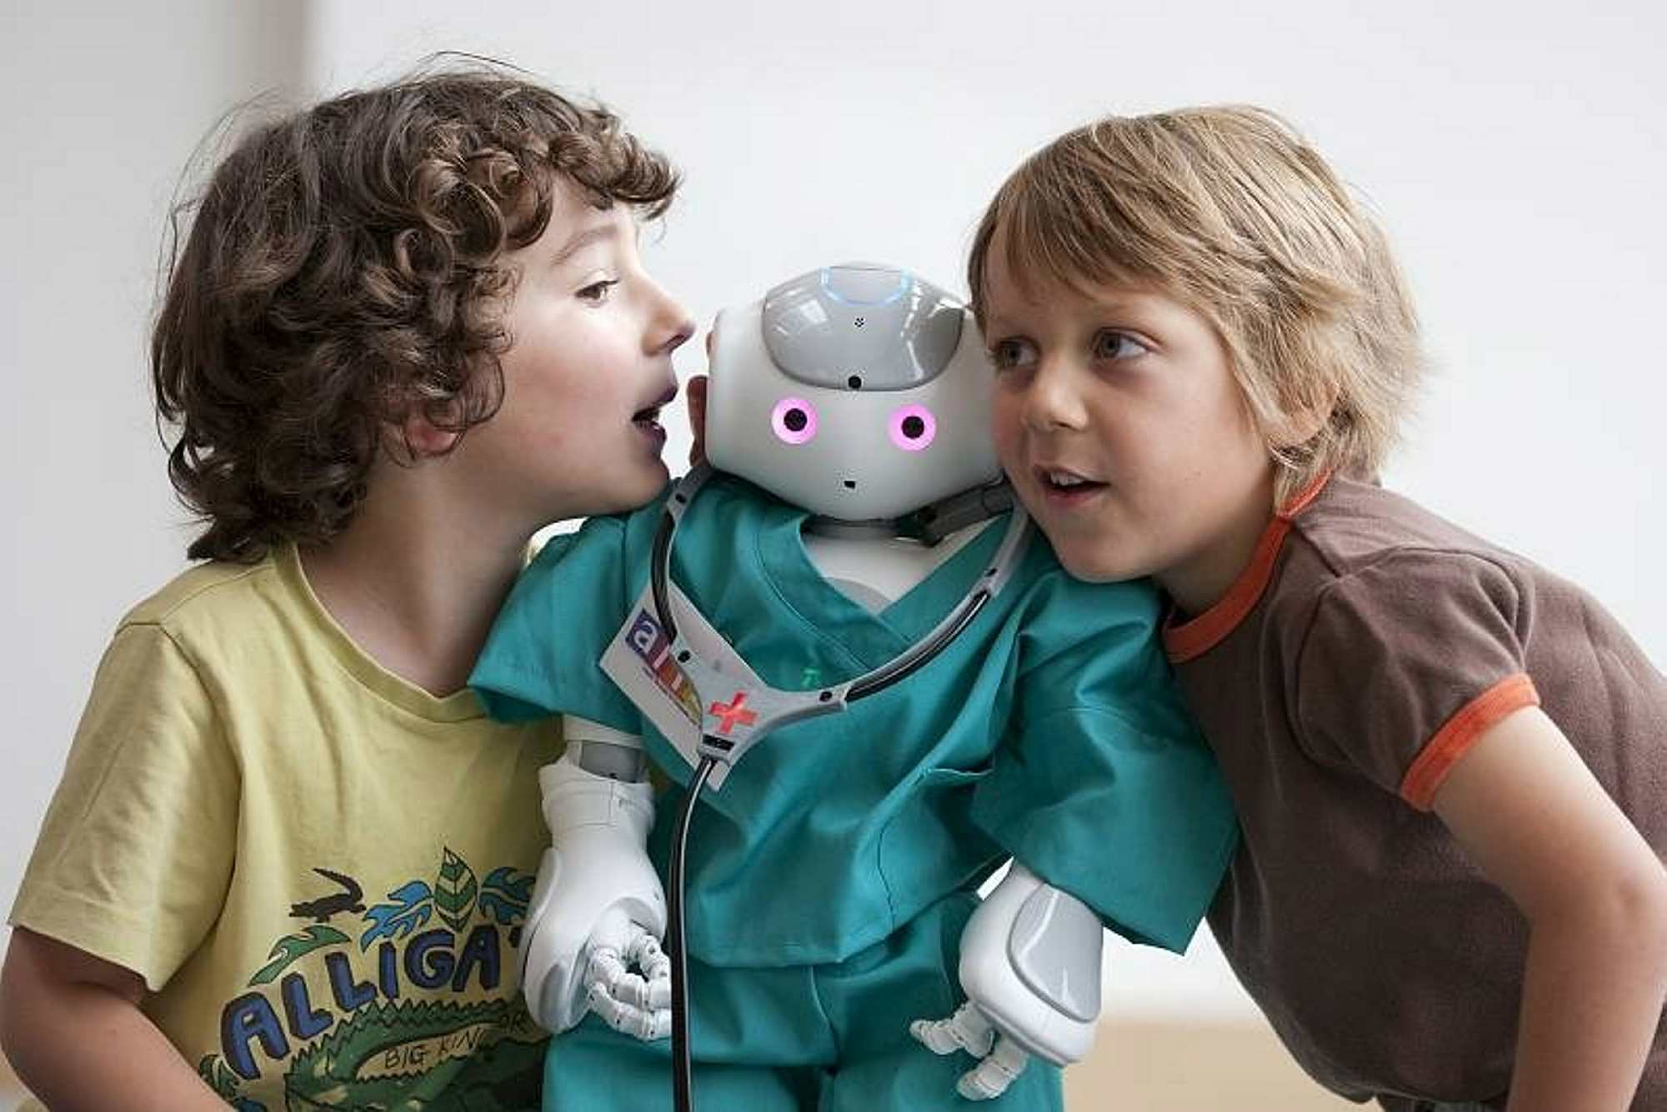
Personal Robotics
Robots = Social Technology

Slide 4

Robots in...

Slide 5
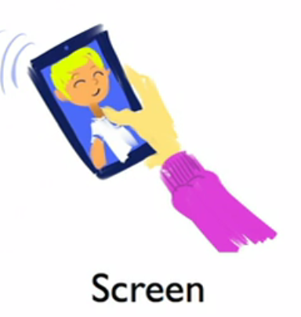
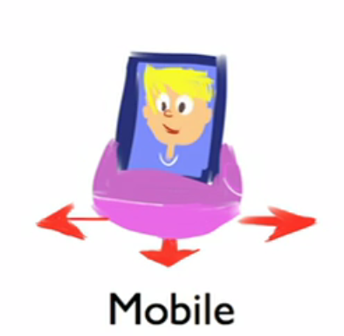
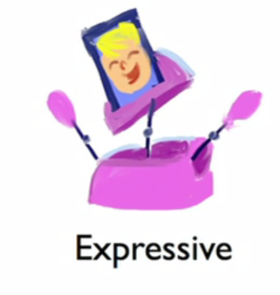
A Difference?
Idea of MeBot.

Slide 6
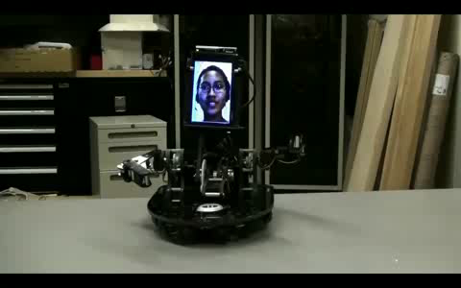
MeBot at MIT Media Lab

Slide 7


Robots in...

Slide 8

Robots in...

Slide 9
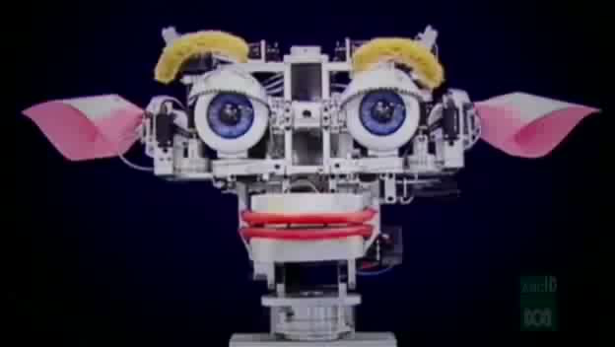
Kismet
First sociable personal robot

Slide 10
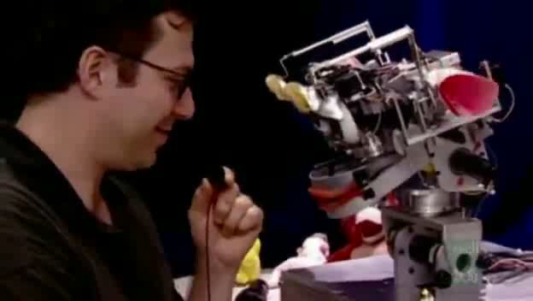
Kismet’s features were made so that he could interact with humans naturally.

Slide 11
To build one..
Real time face tracking.
Speech recognition.
Gesture detection.
Facial expression recognition.

Slide 12
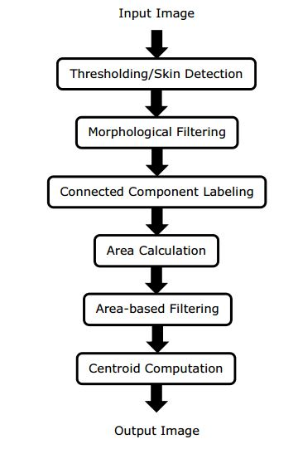
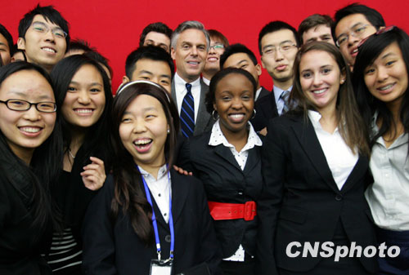
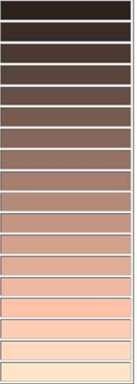
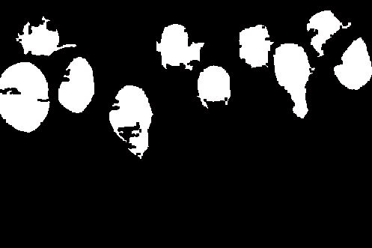
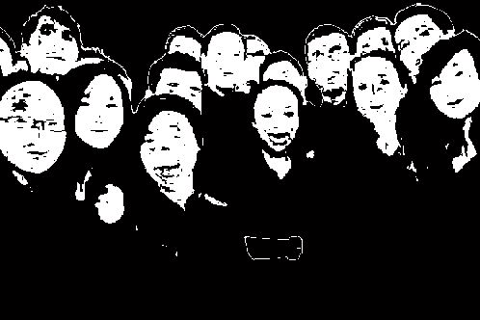
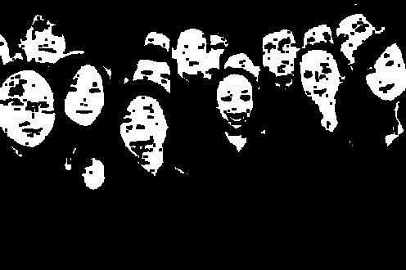
Face tracking algorithm.

Slide 13
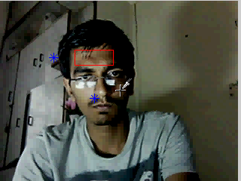
MATLAB implemented real time face tracking

Slide 14
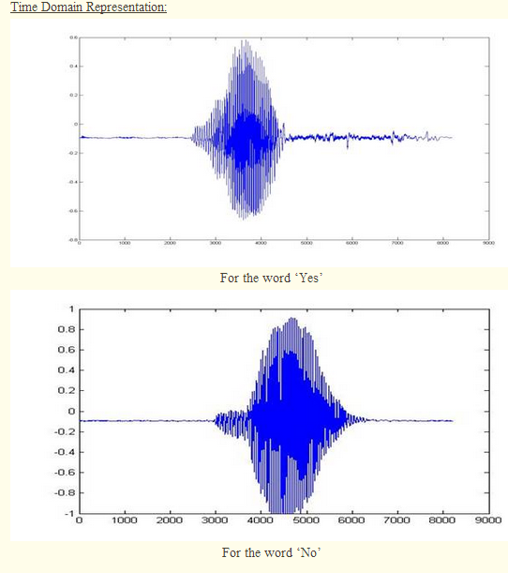
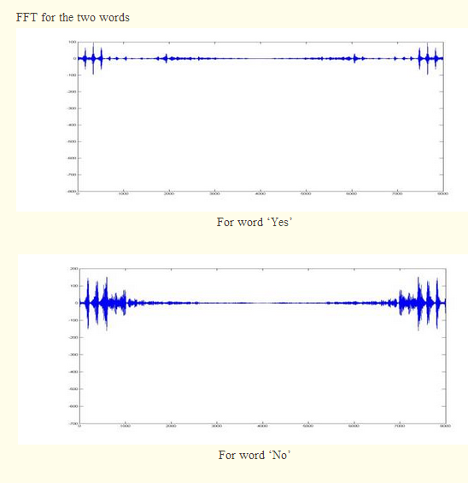
Speech recognition
MATLAB implementation

Slide 15
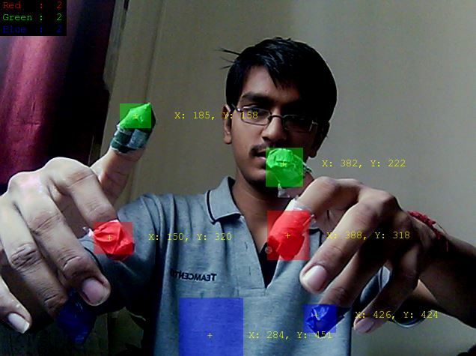
RGB gesture detection

Slide 16
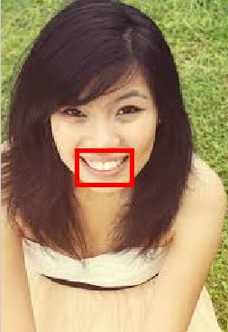
Facial Expression detection
Mouth detection
MATLAB implementation for mouth detection

Slide 17
Conclusion
Robots Are About People

Slide 18
Thank You

